Slide 1
Gitting Started
Open these slides @ http://ap.pn/2mrsSlw
Set up a free account on github.com
Install Git
Mac: sit back and relax!
Windows: download git bash
Linux users run: <package-manager> install git-core
Open your favorite Text Editor:
Download Sublime or Atom if you don’t have one
Notes:
Type git into the terminal - if it knows what the command is then you have git installed (comes by default on OSX)
If you’re on windows and you have never used Git before, you definitely need to install it

Slide 2
How to Git
Intro to Version Control
(C) 2017 Appian Corporation. Distribution with attribution permitted. All other rights reserved

Slide 3
Why do version control systems even exist?

Slide 4
I have a class project
I am given a basic program implementation
My friend has a related program skeleton
We must:
Implement our own program
Integrate with partner’s complete program
Neither program will run without the other
Notes:
This seems like it will be a logistical nightmare. We have to be able to use each other’s work to develop and reach a final product, but we also need to always have a functioning copy of the other file so we have something to develop against.

Slide 5
What Would You Do?
Keep copying and pasting your code in new directories?
Date-stamp and email back and forth?
Suffer (Sending over Messenger)?
Hope?
cmd/ctrl + z?
???
Notes:
When you are working, whether or not it is on your own or in a group, it is always difficult to keep track of the state of your project. If I introduced a bug in my code 2 days ago and never realized it, then what will I do?

Slide 6
Purpose of Version Control Systems
Records changes to files over time
Allows you to easily:
Undo changes or recover files
Compare changes over time
See who last modified a file (including individual lines!)
Determine when code or a bug was introduced

Slide 7
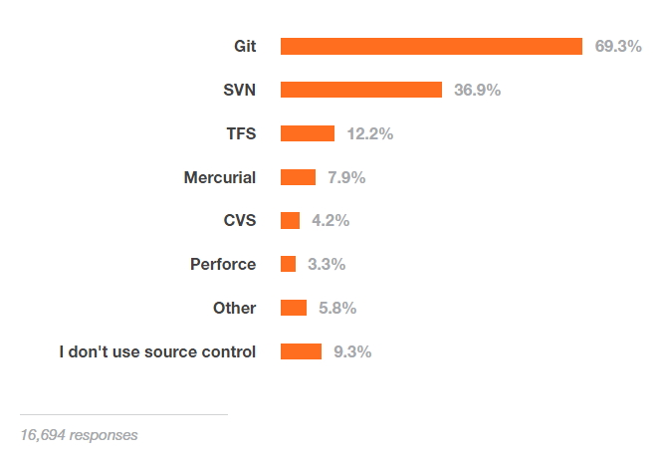
Why are we talking about git?
Source: Sourceforge 2015 developer survey
Notes:
So why git? Git is by far and away the leader in VCS, and it is what we use at Appian!

Slide 8
How do Teams Leverage Git?
Master - Single source of truth
Sharing work
Also, reviewing work (like on github!)
Releasing specific versions
Notes:
Master branch that is always up to date and could be released at any point in time - Single source of truth
Easy to collaborate with git (just pull another teammate’s branch!)
Easy to review people’s work introduced to master on github
Can have branches/tags for specific versions
We have local copy of production ready code, can make edits, then add it to the production ready version

Slide 9
How To Git: Outline
Gitting Started
How Git Works: Repositories
Demo: What the Fork!
How Git Works: Locally
Demo: Pushing Changes
How Git Works: Merging
Demo: Gitting Merged

Slide 10
Gitting Started
Open these slides @ http://ap.pn/2mrsSlw
Set up a free account on github.com
Install Git
Mac: sit back and relax!
Windows: download git bash
Linux users run: <package-manager> install git-core
Open your favorite Text Editor:
Download Sublime or Atom if you don’t have one
Notes:
Type git into the terminal - if it knows what the command is then you have git installed (comes by default on OSX)
If you’re on windows and you have never used Git before, you definitely need to install it
<STUFF> means put in your own string that is relevant to the instructions

Slide 11


How Git Works - Remote Repositories
Remote Repo (What’s on Github)
Source of truth - Master
Readable by team members
Team can contribute
Notes:
1 central repository online - anyone on team can access, reference, and contribute to
Forking = Duplicating existing repository for personal use
If collaborating on github, every team member will have their remote repository that is a fork of the main remote repository, and then will make PRs against the main remote repository to integrate their code.
Versions of code hosted on services like github
Any team member can read, accesses, and contribute to the repository that is not on your own machine
Images
Github Cat: https://www.flickr.com/photos/jonobacon/22160892602 licenced by: jonobacon, with: https://creativecommons.org/licenses/by/2.0/
Cloud Image: https://commons.wikimedia.org/wiki/File:Ic_cloud_queue_48px.svg licenced by: google, with: https://creativecommons.org/licenses/by/4.0/deed.en

Slide 12


How Git Works - Local Repositories
Local Repo
(What’s on your computer)
A clone of the remote repo
Readable only by you
Only you can contribute
Git allows you to make changes locally and push them to the remote repository when you are ready.
Notes:
Cloning = Downloading copy of repository to local machine
Images
Laptop image: https://commons.wikimedia.org/wiki/File:Devicetemplates_laptop-02.png licenced by: Rudloff, with: https://creativecommons.org/licenses/by-sa/3.0/deed.en
Git image: https://commons.wikimedia.org/wiki/File:Git_icon.svg licenced by: Jason Long, with: https://creativecommons.org/licenses/by/3.0/deed.en

Slide 13
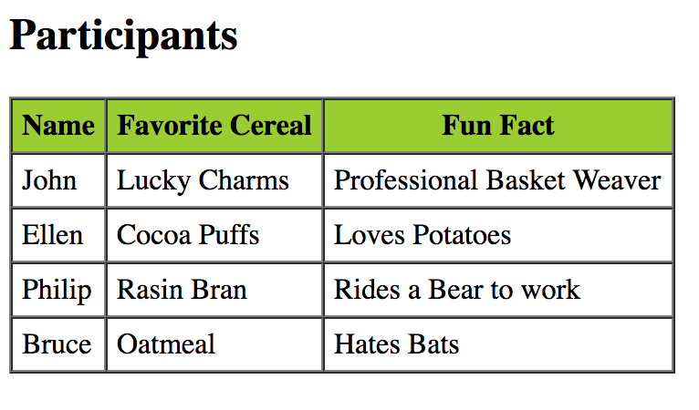
What are we building today?
XML
All Bios
Webpage
Participant Bios
<tr>
<td>Bruce</td>
<td>Cocoa Puffs</td>
<td>Fears Bats</td>
</tr>
Notes:
For this demo we will each be creating an xml file with some basic facts about ourselves.
When we combine our files we will run a script to create an html file with all of our information
Everyone is going to give their name, favorite breakfast cereal, and a fun fact about you

Slide 14
Demo: What the Fork!
a
Fork the Participant Bio repo at http://ap.pn/21KjxqB (case sensitive)
Clone the repo to your personal machine
On the command line (or Git Bash if on Windows) navigate to where you want to put the project folder
Enter the following command:
git clone https://github.com/<<YOUR_GITHUB_USERNAME>>/GitHackathon.git
Success! you should now have a copy of the project on your computer
Notes:
Mention what Forking actually is - just making a copy of someone else’s repo
Talk about what this repo is for!
Forking is making a copy of someone else's repo for personal use. For us, this is going to be copying the main GitHackathon repo so we can make our own modifications to it.
When we clone a repository, we are copying that repository onto our local machine. This is where we will actually make edits to code. Our clone will look like a normal folder in our local filesystem, but with additional capabilities that are provided by the git properties files packaged into the repo.

Slide 15

How Git Works Locally - Intro
a
w/o git
v1
v2
v3
w/ git
Notes:
Be careful on terminology -- used "checked out" files, they might not know what that means
Images
File images are made by appian
Explosion icon from: https://pixabay.com/en/atomic-bomb-cloud-explosion-1294354/ licenced with: CC0 Public Domain

Slide 16
Version Control
Notes:
Committing = Saving
Pushing = uploading changes
Pulling = Fetch changes and merge into active branch
We are now ready to write the code for this part of the project. So we sit down at our computer and?
We need to download the code first, so how do we do that effectively? We could run flash drives to one another or recite the code as an oral tradition. However we need a process that is easier to manage than that.
1st slide: Git
We use git & github to manage all of our code.
Git is a Version Control tool to let us keep history of our work (so you can step back to older versions of the project) github is a service that allows us to push our code to an online repository.
So we are going to pull down the project, make our changes, package the changes using git (called making a commit) and then push that commit up.
I could have multiple versions of the code locally if I wanted to work on multiple things at the same time. In git these versions are called branches. (Branches are like pointers to commits)

Slide 17
How Git Works Locally - Branching
Notes:
Branches are separate chains of work. They allow you to work on one set of code (feature) without affecting another one you may also be doing. To switch the feature you are working on you just checkout a new branch for that feature.
You can switch branches by running git checkout <branch-name>

Slide 18

How Git Works Locally - Adding
Staging Area
git add
Notes:
You decide to add your file to git using git add index.html.
What does this do?
Adds your file to the "Staging Area"
This does not remove the file from the "Working Directory"
What happens if you accidentally deleted index.html?
You still have the changes in your staging area
File, and Computer icons are made by appian
Camera image from: https://pixabay.com/en/camera-the-stroke-icon-logo-sign-2112207/

Slide 19
How Git Works Locally - Committing
Staging Area
.git repo
git commit
Notes:
Speak to this as a “snapshot of time” for the state of the repo.
Call out what’s DIFFERENT about the git add stage and the git commit stage.
You've now saved at a save point and can reference it later!
After adding a version of index.html that you are satisfied with to the staging area, you decide to commit the changes using git commit.
What does this do?
Stores your changes in the .git repository
What happens if you accidentally deleted index.html?
You can reset the value of index.html to the value from the commit

Slide 20

How Git Works Locally - Pushing
git push
Notes:
Speak to this as a “snapshot of time” for the state of the repo.
Add “git push

Slide 21
How Git Works Locally - Workflow
git push
git add
git commit
Notes:
Speak to this as a “snapshot of time” for the state of the repo.
Add “git push

Slide 22
Version Control: Teamwork
master
Notes:
You can have one common base of code for people to push their code to but if you do that you will probably have a bad time.
Git and github allow you to have separate “branches” of work (or forks), so if Kevin is making some changes and I am making some changes we don’t accidently step on each others toes.
As we do work we can open pull requests for teammates to review and when our code is “ready” it will be merged into the master branch.
This approach can scale well, we have over 100 people working in the same code base using git for version control
Git and github are free to use so check them out if you are building a project with others. There are also alternatives git, such as svn.

Slide 23
Demo: Checking Out a Branch
15 min
We want to add a new participant to our Participant Bio (GitHackathon) repository .
Checkout a new branch to add our name with the following syntax:
git checkout -b add-<your-name>-info
Check the status of your branch:
git status
Notes:
*To see how git tracks your changes through this process run:
git status
between each step
HEAD is a special git word that points to the last commit that you made

Slide 24
Demo: Making Changes
15 min
Make a copy of participantTemplate.xml and put it in the participants directory. Name the file <YourName>.xml
Open up the file you created in an editor and update the information to pertain to you
Check the status of your branch:
git status
Notes:
*To see how git tracks your changes through this process run:
git status
between each step
HEAD is a special git word that points to the last commit that you made
<html>
<head>
<meta charset="utf-8">
<title>Welcome to the Appian Git and Teamwork Workshop</title>
<basefont size=4>
<style>
table {
width:100%;
}
table, th, td {
border: 1px solid black;
border-collapse: collapse;
}
th, td {
padding: 5px;
text-align: left;
}
</style>
</head>
<body bgcolor="#D3D3D3">
<h1>Welcome to the Appian Git and Teamwork Workshop</h1>
<h3>Purpose of Git</h2>
<ol>
<li>Record changes to files over time</li>
<li>Undo changes or recover files</li>
<li>Compare changes over time</li>
<li>See who last modified a file</li>
<li>Determine when code or a bug was introduced</li>
</ol>
<h4>TL;DR it's easy to fix mistakes!</h4>
<h3 align=center>Tell us about yourself!</h3>
<tble>
<tr>
<th>Name</th>
<th>Favorite Cereal</th>
<th>Fun Fact (or favorite programming language)</th>
</tr>
<tr>
<td>Ben</td>
<td>Reeses Puffs</td>
<td>I like sandals</td>
</tr>
</talbe>
<p>Remember, you can view the HTMl code from this or any other page by using the "View Page Source" command of your browser.</p>
<h2>List about why I like git</h2>
<ol>
<li>It works with github</li>
<li>Changing my local branch to any point in history is really easy</li>
<li>It's easy to merge with the master branch</li>
</ol>
</body>
</html>

Slide 25
Demo: Pushing Changes
15 min
Add the changes on the command line git add participants/<YourName>.xml
Check the status of your changes git status
Commit the changes git commit -m “<your name> information added”
Push the new commit up to your fork and enter your credentials git push origin HEAD
Notes:
*To see how git tracks your changes through this process run:
git status
between each step
HEAD is a special git word that points to the last commit that you made
<html>
<head>
<meta charset="utf-8">
<title>Welcome to the Appian Git and Teamwork Workshop</title>
<basefont size=4>
<style>
table {
width:100%;
}
table, th, td {
border: 1px solid black;
border-collapse: collapse;
}
th, td {
padding: 5px;
text-align: left;
}
</style>
</head>
<body bgcolor="#D3D3D3">
<h1>Welcome to the Appian Git and Teamwork Workshop</h1>
<h3>Purpose of Git</h2>
<ol>
<li>Record changes to files over time</li>
<li>Undo changes or recover files</li>
<li>Compare changes over time</li>
<li>See who last modified a file</li>
<li>Determine when code or a bug was introduced</li>
</ol>
<h4>TL;DR it's easy to fix mistakes!</h4>
<h3 align=center>Tell us about yourself!</h3>
<tble>
<tr>
<th>Name</th>
<th>Favorite Cereal</th>
<th>Fun Fact (or favorite programming language)</th>
</tr>
<tr>
<td>Ben</td>
<td>Reeses Puffs</td>
<td>I like sandals</td>
</tr>
</talbe>
<p>Remember, you can view the HTMl code from this or any other page by using the "View Page Source" command of your browser.</p>
<h2>List about why I like git</h2>
<ol>
<li>It works with github</li>
<li>Changing my local branch to any point in history is really easy</li>
<li>It's easy to merge with the master branch</li>
</ol>
</body>
</html>

Slide 26
Creating a Pull Request
Navigate to your repository
Click “branches”
Click “New Pull Request” from your “add-<your-name>-info” branch
Make sure to specify our repository to create the PR against: FuadBalashov/GitHackathon
Notes:
Don’t merge here, wait for people to open their branches, then merge to bring in the merge conflict
Explain that opening this PR is how you merge a PR.

Slide 27
Now you try!
Add yourself as a participant and create your own PR!
Git reference:
git status
git checkout -b add-<your-name>-info
git add participants/<YourName>.xml
git commit -m “<your name> information added”
git push origin HEAD
Go to your branch and create a pull request
Notes:
This is a waiting slide where we merge everyone’s PR before moving on.
AND show the new html file that gets created.
Then in the next section someone will get the latest master branch and change every participants.xml file

Slide 28
Merging: Intro
Jill
Joe
Jane
Dan
Notes:
Let’s go through a simple example of merging two text files
When we merge our work into another branch/fork Git applies our changes.
Sometimes Git can't automatically merge your stuff with someone else's, so you have to tell it what you want the end result to be.
During these slides we have to merge the commit that introduces merge conflicts with everyone

Slide 29
Merging: Changes Git Can Resolve
Jill
Kevin
Joe
Jane
Dan
Jill
Kevin
Joe
Jane
Dan
Jill
Joe
Jane
Dan
Notes:
When we merge our work into another branch/fork Git applies our changes.
Sometimes Git can't automatically merge your stuff with someone else's, so you have to tell it what you want the end result to be.

Slide 30
Merging: More Than One Change
Jill
Kevin
Joe
Jane
Linda
Dan
Jill
Kevin
Joe
Jane
Dan
Jill
Joe
Jane
Dan
Jill
Joe
Jane
Linda
Dan
Notes:
When we merge our work into another branch/fork Git applies our changes.
Sometimes Git can't automatically merge your stuff with someone else's, so you have to tell it what you want the end result to be.
A merge conflict occurs when Git does not know how to merge your changes

Slide 31
Merging: Changes in the Same Place
Jill
Kevin
Joe
Jane
Dan
Jill
Joe
Jane
Dan
Jill
Linda
Joe
Jane
Dan
Notes:
When we merge our work into another branch/fork Git applies our changes.
Sometimes Git can't automatically merge your stuff with someone else's, so you have to tell it what you want the end result to be.
A merge conflict occurs when Git does not know how to merge your changes

Slide 32
Merging: Permutations
Jill
Kevin
Linda
Joe
Jane
Dan
Jill
Linda
Kevin
Joe
Jane
Dan
Jill
Kevin
Joe
Jane
Dan
Jill
Linda
Joe
Jane
Dan
Notes:
When we merge our work into another branch/fork Git applies our changes.
Sometimes Git can't automatically merge your stuff with someone else's, so you have to tell it what you want the end result to be.

Slide 33
Merging: What We Don't Want
Jill
Kevin
Linda
Joe
Jane
Dan
Jill
Linda
Kevin
Joe
Jane
Dan
Jill
Kevin
Joe
Jane
Dan
Jill
Linda
Joe
Jane
Dan
Notes:
When we merge our work into another branch/fork Git applies our changes.
Sometimes Git can't automatically merge your stuff with someone else's, so you have to tell it what you want the end result to be.

Slide 34
Merging: Commits and Parents
Initial Names
Linda
Kevin
Merge!
Notes:
When we merge our work into another branch/fork Git applies our changes.
Sometimes Git can't automatically merge your stuff with someone else's,so you have to tell it what you want the end result to be.

Slide 35
Demo: Fixing a bug
15 min
It looks like the fun fact section of the participants list didn’t get populated. Let’s fix that!
Checkout a new branch
git checkout -b fixMergeConflict
Camelcase (“funfact” → “funFact”) in your participants/<YourName>.xml file so that it appears correctly in the html file.
Add, commit, and push your changes. Then make a new PR against: FuadBalashov/GitHackathon
Notes:
Now we are going to fix the bug we saw earlier.

Slide 36
Demo: Merge Conflict!
15 min
It looks like someone has updated all of the participant.xml files on the master branch.
To resolve this conflict we have to pull the master branch and update our local branches with the latest changes.
To pull the master branch we will have to add a new remote!
Notes:
Oh no we have a merge conflict!

Slide 37
Demo: Adding a New Remote
We need to add Fuad’s github repository as a remote to fetch his code so that we can resolve the merge conflict.
Add Fuad’s branch as a remote like this:
Fetch master to get the latest updates:
git remote add appian https://github.com/FuadBalashov/GitHackathon.git
git fetch appian master
git pull appian master
Notes:
Adding appian’s remote to resolve the conflict

Slide 38
Demo: Gitting Merged
To fix these merge conflicts, we should update to the latest version of master, resolve the merge conflict, and then push back up the result.
See which files have merge conflicts git status
Resolve the merge conflict and commit the result
git commit -m “fixed the issue”
Push back up git push origin HEAD
Git merged!
Notes:
Let's explain "git pull" here -- how is it different from git clone?
Git merged!

Slide 39
Now you try!
Try to update your file and then resolve the merge conflict!
git status
git checkout -b fixMergeConflict
git add participants/<your-name>.xml
git commit -m “<some message>”
git push origin HEAD
Now create a Pull Request and see that it can’t merge.
Add appian as a remote and fix merge conflict:
git remote add appian https://github.com/FuadBalashov/GitHackathon.git
git pull appian master
*Fix conflicts*
git add <any files that had conflicts>
git commit -m “fixed conflicts”
git push origin HEAD
Notes:
This is a waiting slide where we merge everyone’s PR before moving on.
AND show the new html file that gets created.
Then in the next section someone will get the latest master branch and change every participants.xml file

Slide 40


Congratulations!
Please fill out this short survey to help us improve this workshop!
ap.pn/2oqgFNq
More Git Foo
Branching
Rebasing vs. Merging
Force Pushing
Stashing
Diffing
Git Game
Notes:
Images
Hat: https://thenounproject.com/term/magician/606092/ licensed by: Ken Murray, with: https://creativecommons.org/licenses/by/3.0/us/
Git Icon: https://commons.wikimedia.org/wiki/File:Git_icon.svg licensed by: Jason Long, with: https://creativecommons.org/licenses/by/3.0/deed.en

Slide 41

Next Steps? Git Going!
To make a new project and put it on github, follow these steps.
If you run into any issues stop by Appian’s Table.
Get the Github Student Dev Pack
Use our handy-dandy cheat sheet!

Slide 42
Hints for the Hackathon
Notes:
Show of hands: Who loves working on a team? Talk about team projects.

Slide 43


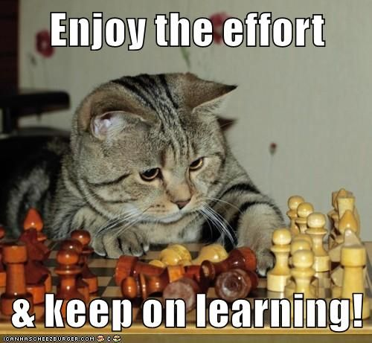
Grow your Skills
Notes:
Pick a project that will grow your skills
Pick something that you think you will enjoy today and in the future.
It’s okay/encouraged to be uncomfortable!

Slide 44
Set Common Goals
Goal 1: Finish entire presentation!
Notes:
Set common goals
An important aspect is that goals should be granular enough to set up checkpoints to give each other feedback.
Goal one should not be “Finish the presentation!”
Instead, we set easily achievable goals that conceivably grow in scope, but at every stage we’re talking to each other, confirming what we’ve achieved and deciding on next steps.

Slide 45
Set Common Goals
Goal 1: Finish entire presentation!
Notes:
Set common goals
An important aspect is that goals should be granular enough to set up checkpoints to give each other feedback.
Goal one should not be “Finish the presentation!”
Instead, we set easily achievable goals that conceivably grow in scope, but at every stage we’re talking to each other, confirming what we’ve achieved and deciding on next steps.

Slide 46
Set Common Goals
Goals:
Review existing content
Confirm what additions we need
Review teamwork tactics
…
…
Confirm Hackathon travel arrangements :)
Notes:
Set common goals
An important aspect is that goals should be granular enough to set up checkpoints to give each other feedback.
Goal one should not be “Finish the presentation!”
Instead, we set easily achievable goals that conceivably grow in scope, but at every stage we’re talking to each other, confirming what we’ve achieved and deciding on next steps.

Slide 47
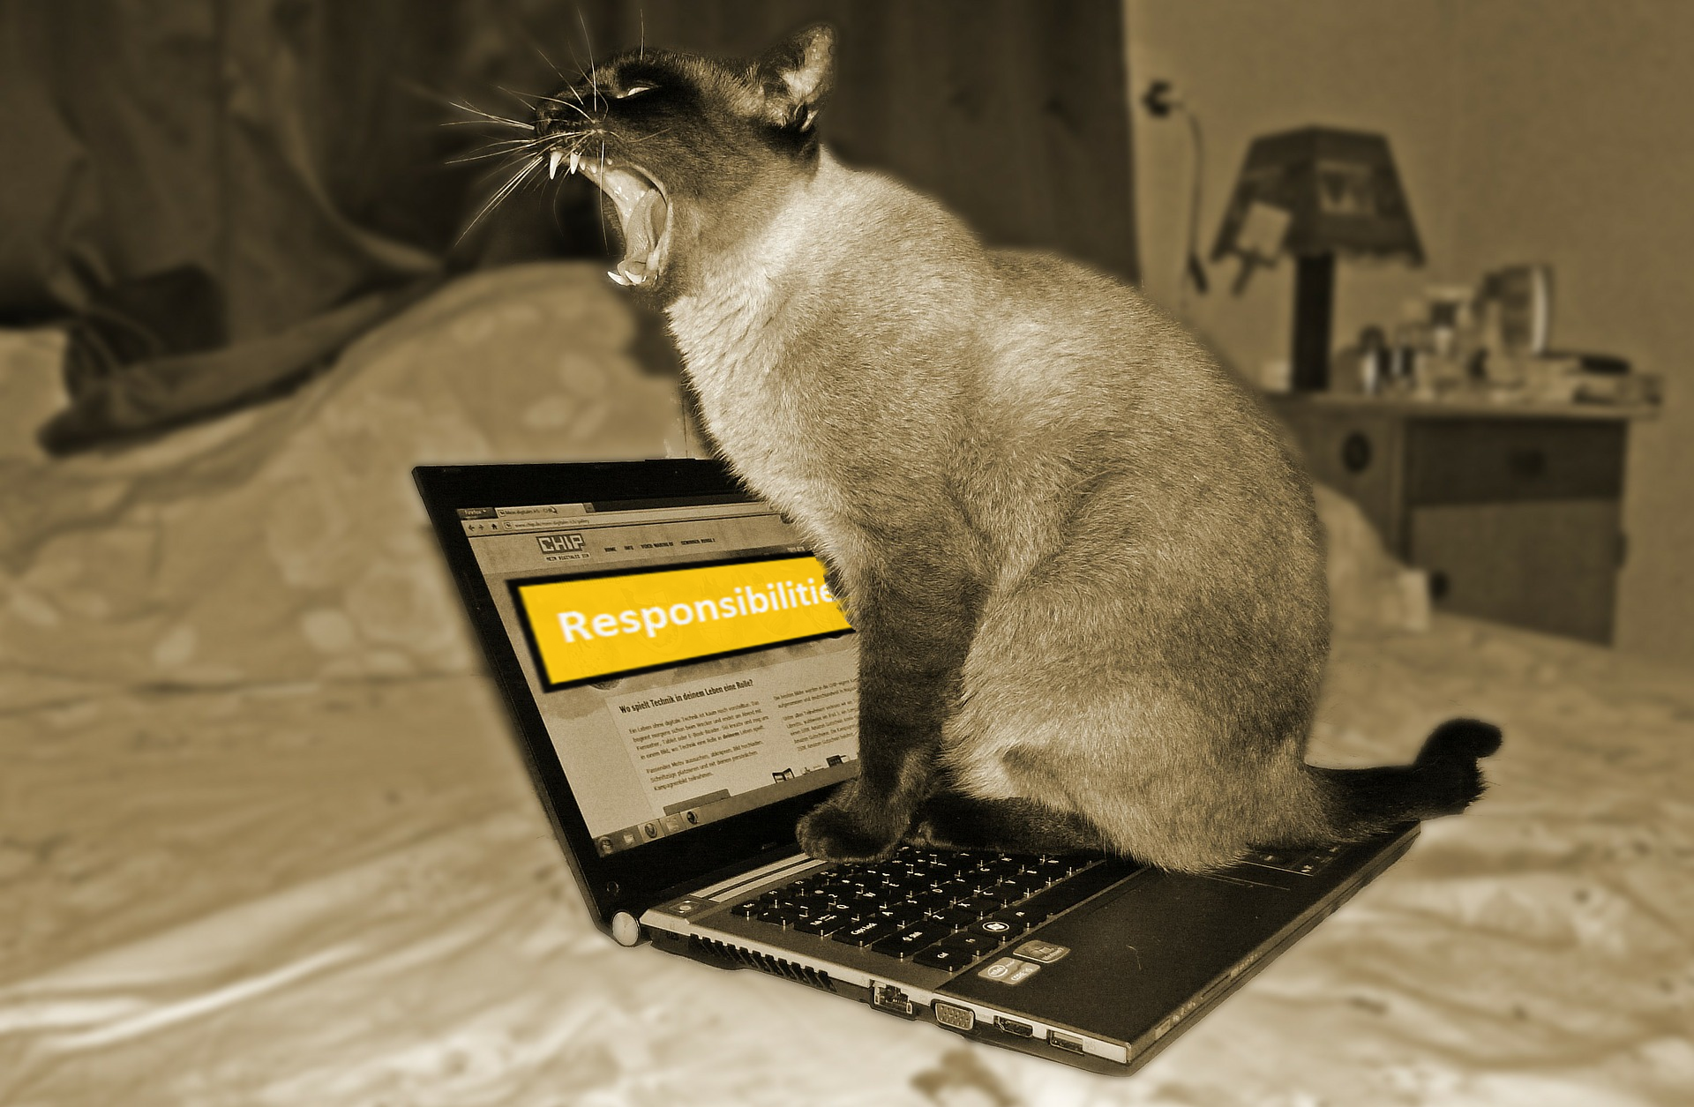
Clarify All Responsibilities
Mine!, They’re all mine!
Notes:
Clarify all responsibilities
At the outset, assign people areas they “own.” This will avoid overlapping authority. It also highlights gaps in the skills and overloading of people. If I “own” 4/5ths of the project and you only own 1/5th, that is a problem. Maybe as big a problem that we shouldn’t be working together, but at the very least maybe I can relinquish another 1/5th of the project to you.
In our case, we decided primarily based on interest how to split the work. I cared about the teamwork stuff and viewed it as one of the more important skills you can learn and develop. Aboli really wanted to present the guts of git.
We all wanted to make sure the presentation was good, so we all shared review and critiquing.
Images:
Cat: https://www.flickr.com/photos/8695125@N08/543442991 by: John Stansbury licensed under: https://creativecommons.org/licenses/by/2.0/

Slide 48

Encourage Open Communication
Notes:
Encourage open communication
This is most important, but also the hardest thing to do. It’s very easy to break down and unintentionally shut down communication. It’s also a whole other presentation.
Some quick things you can do now, though:
Ask questions, instead of making statements.
Don’t assume you understood the other person, repeat what they said in your own words and ask for confirmation that you understood them correctly.
When presenting your idea, ask what you are missing/what’s wrong with the idea, rather than prompting for agreement and acceptance.
Images:
Tin can phone: https://www.pexels.com/photo/marketing-man-person-communication-362/

Slide 49

Pair Programing
ONE MACHINE
NAVIGATOR
DRIVER
Notes:
“Pair up” with team members to share knowledge, learn about new technology. One person directs the other and can gather information/answer questions as the other codes. Remember to switch it up.(use nicholas’s pairing slide for this)
Images:
Driver Navigator: http://bitvbit.blogspot.com/2017/03/images.html by: BitvBit, licensed with https://creativecommons.org/licenses/by-sa/4.0/deed.en

Slide 50
Mistakes the Driver would make
Actual Mistakes
Mistakes the Navigator would make

Slide 51


Back to Basics
Notes:
Sleep
Stay calm, friendships > hack
Use git, it saves you from losing work and makes it easier to collaborate.
Images
Sleeping: https://pixabay.com/en/sleeping-bed-sleeping-room-rest-297724/ with: CC0

Slide 52

Continue Beyond the Hackathon
Notes:
Keep building your project after the hackathon, polish it and keep growing your skills
Continue project after the hackathon (projects are never done!)
Keep working on projects that interest you that grow your skills -- you don’t need a hackathon to start a new project!
Images
Teamwork from: https://www.flickr.com/photos/lumaxart/2137737248

